Slide 1

ASAP IDEA FEST
MONTHLY IDEATHON SERIES
NOVEMBER 2024
Serenity Squad

Slide 2
The Team- Serenity Squads
Team Leader - Farhana Afrin
Members
Alvira Ruchbah
Athira M
Aneena Chandran
Institution- LBS College of Engineering Kasaragod

Slide 3
Problem Statement
Identify and address the key factors affecting the mental health of youth by developing solutions that promote emotional well-being, resilience, and access to mental health resources. The solution should focus on reducing stigma, providing support systems, and creating awareness about mental health challenges faced by young people in today’s fast-paced and digitally-driven world.

Slide 4
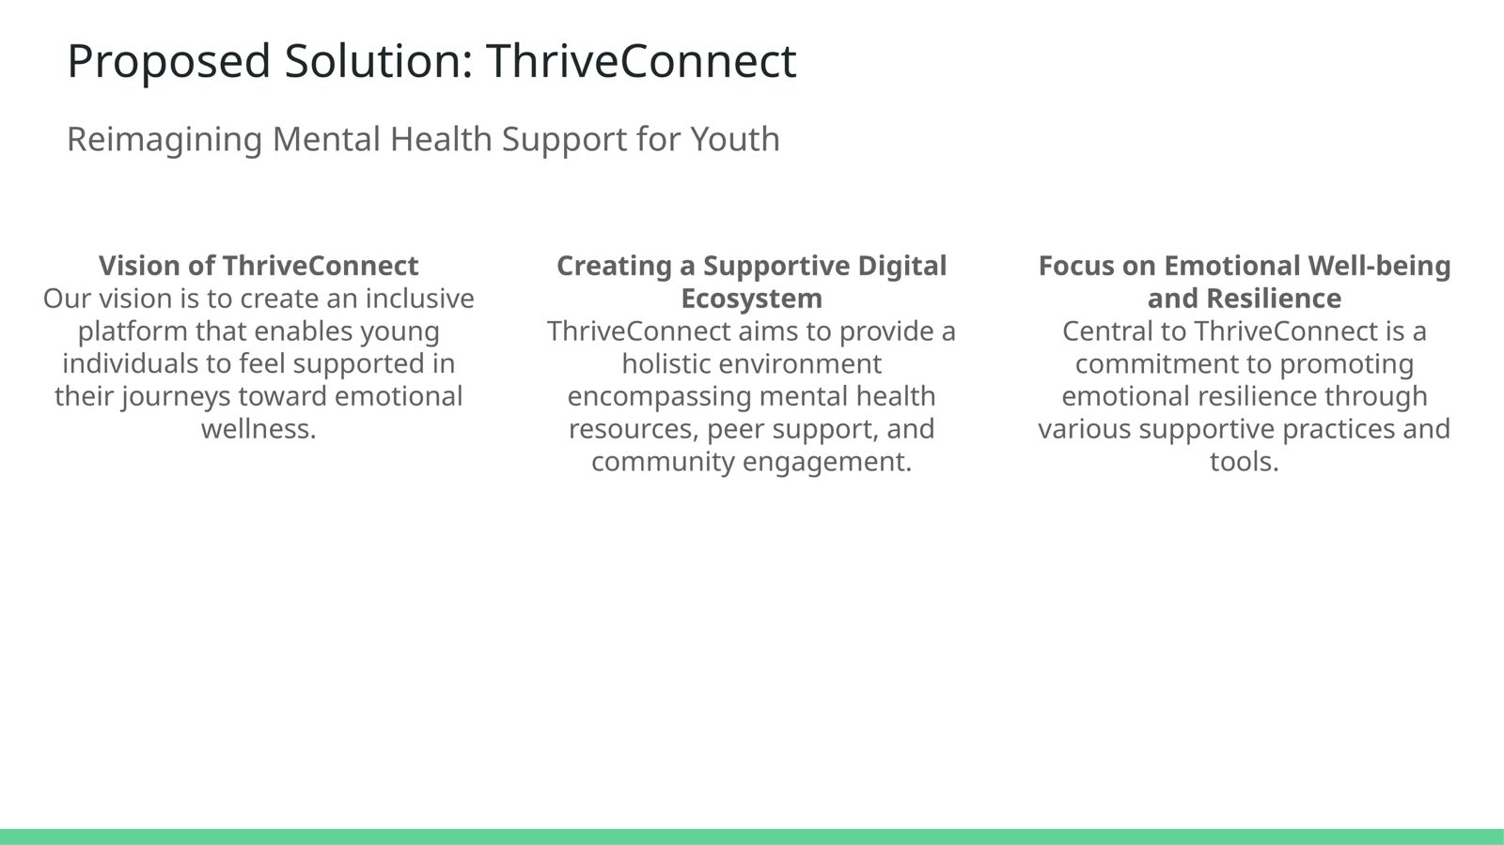

Slide 5
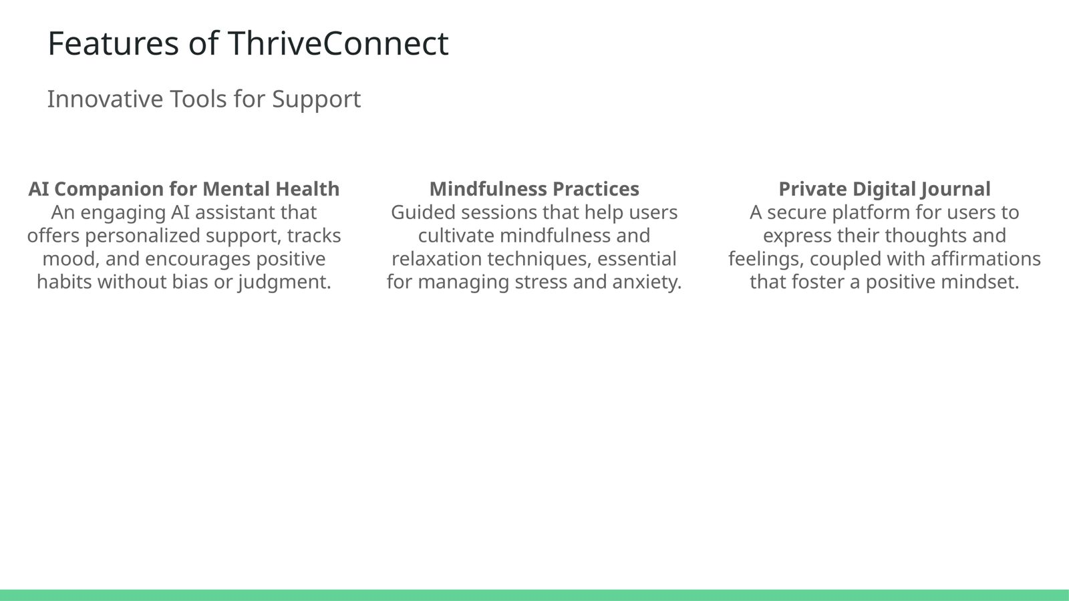

Slide 6
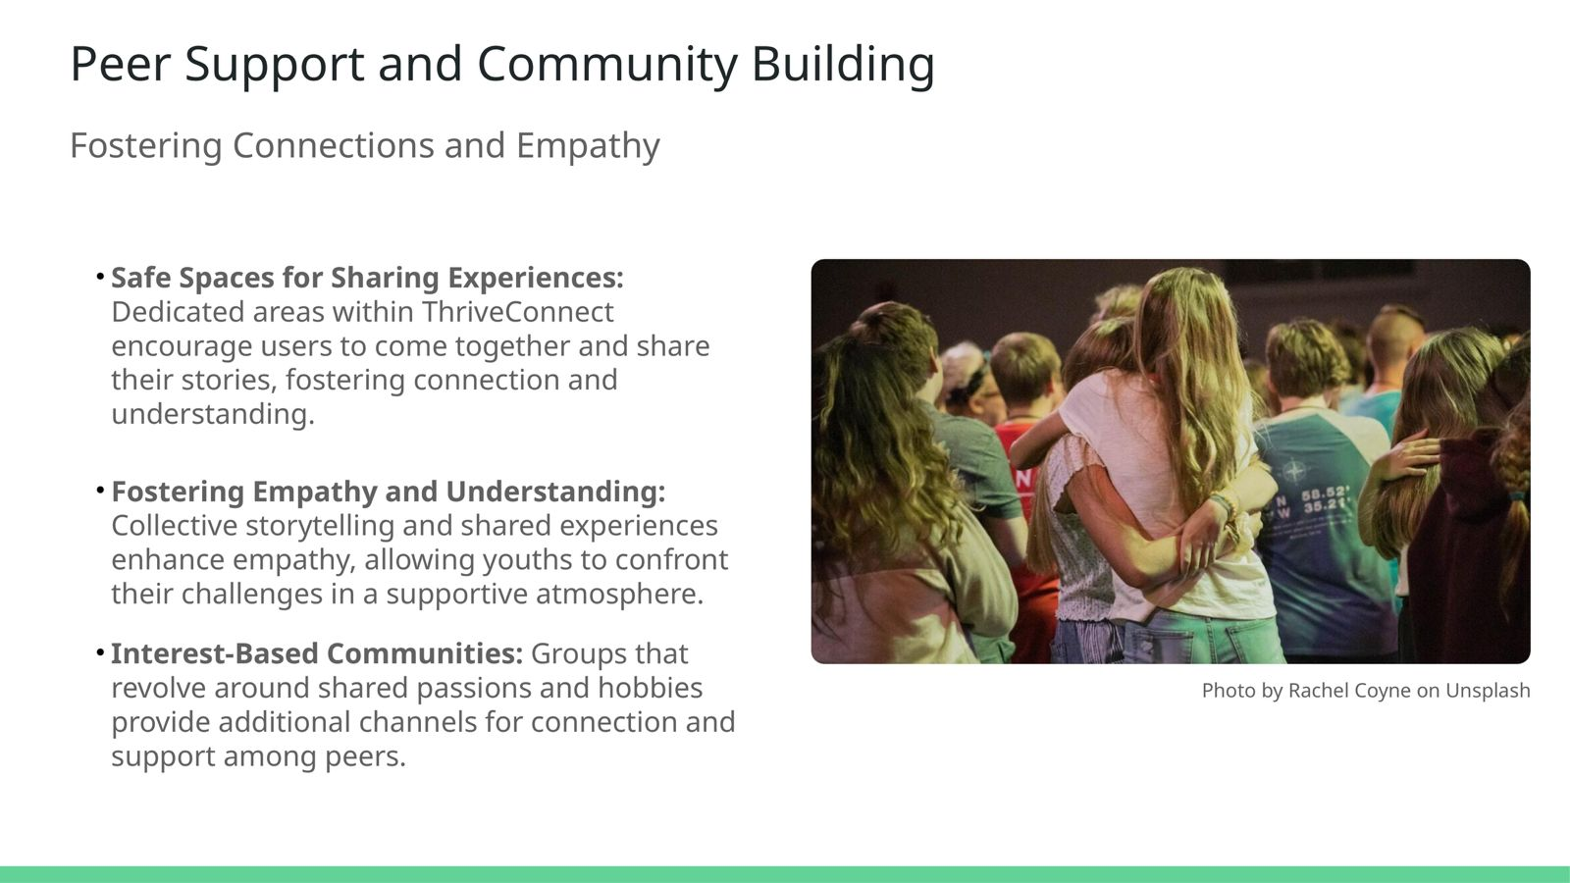

Slide 7


Slide 8
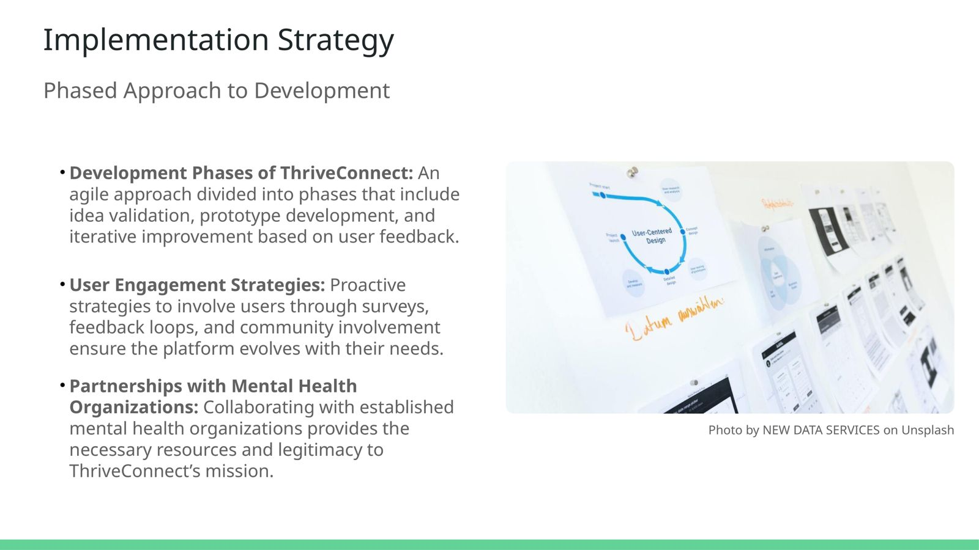

Slide 9
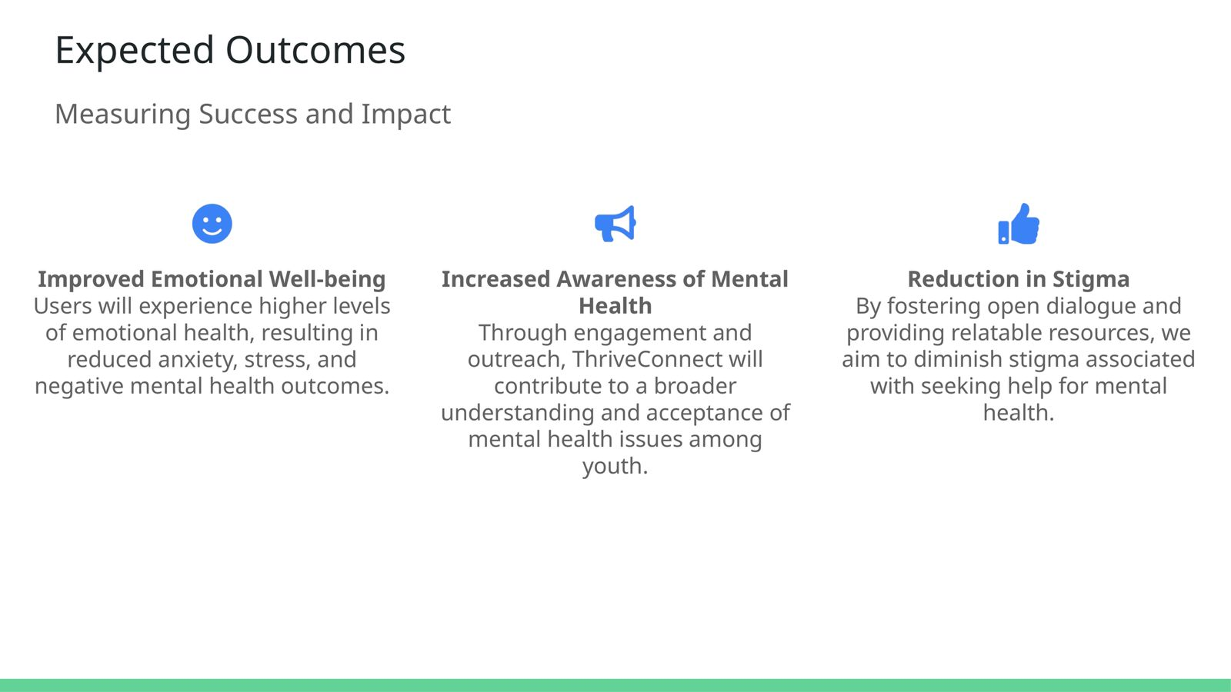
Impact and Benefit

Slide 10
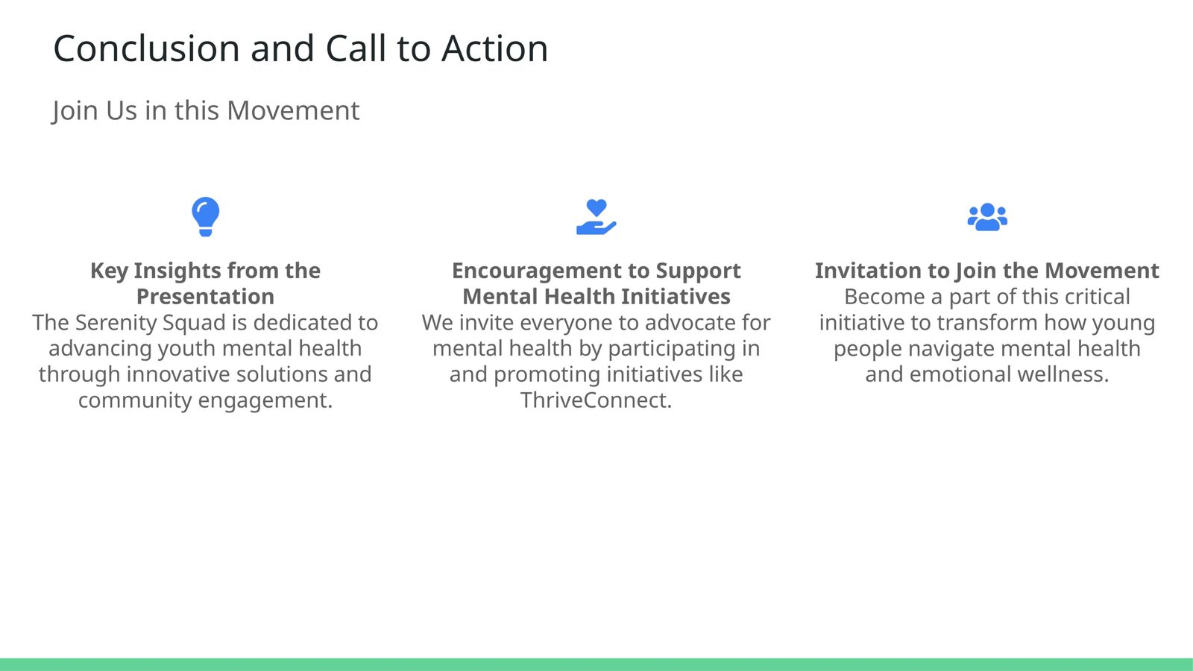

Slide 11
THANK YOU

Slide 12
TEAM DETAILS
SL.NO | NAME | MAIL ID | PHONE NUMBER
1 | Alvira Ruchbah | alviraruchbah123@gmail.com | 9526942235
2 | Farhana Afrin | farhana2005afrin@gmail.com | 7034680329
3 | Athira M | athira.mullacheri118@gmail.com | 9747843057
4 | Aneena Chandran | aneenachandran179545@gmail.com | 8921633735

